Slide 1

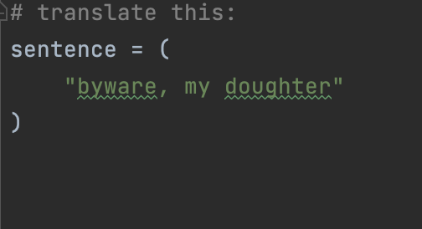
Þe Futur of Translacioun
A Middle English Translator Using Neural Machine Translation
Notes:
Make sure to share handout!
Have Pycharm booted up in case of questions

Slide 2
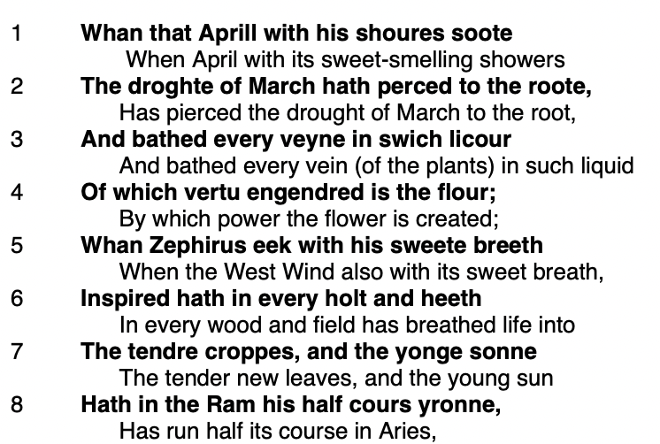
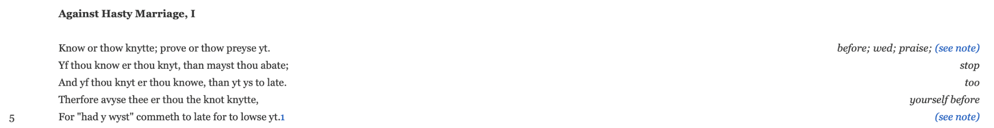
The Goal
(The Canterbury Tales)
What translations should look like
(“Against Hasty Marriage, I”)
Notes:
When people are reading Middle English, their options are often to read a translation, sometimes an abbreviation, or to translate it themselves.
Translating ME themselves can be difficult, but it allows the reader to have their own interpretation of the original text, so I want to make it easier for people to translate ME by supplementing it with translations.
These are examples of that: you can see that the reader still has the original text available to them but words they might not know are given to them so they can read more smoothly
Top image: Chaucer, G. (2008). The Riverside Chaucer (L. Benson, R. Pratt, & F. Robinson, Trans.; 3rd ed.). Houghton Mifflin Company. https://sites.fas.harvard.edu/~chaucer/teachslf/tr-index.htm (Original work published 1986)
‌
Bottom image: Salisbury, E. (2002). The trials and joys of marriage. Medieval Institute Publ., Western Michigan University. https://d.lib.rochester.edu/teams/publication/salisbury-trials-and-joys-of-marriage

Slide 3
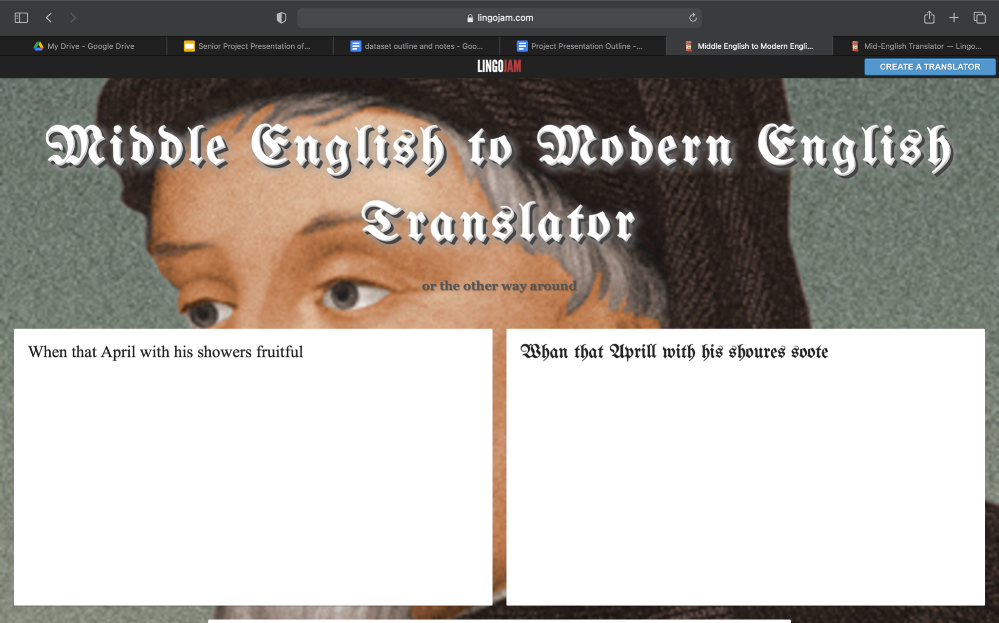
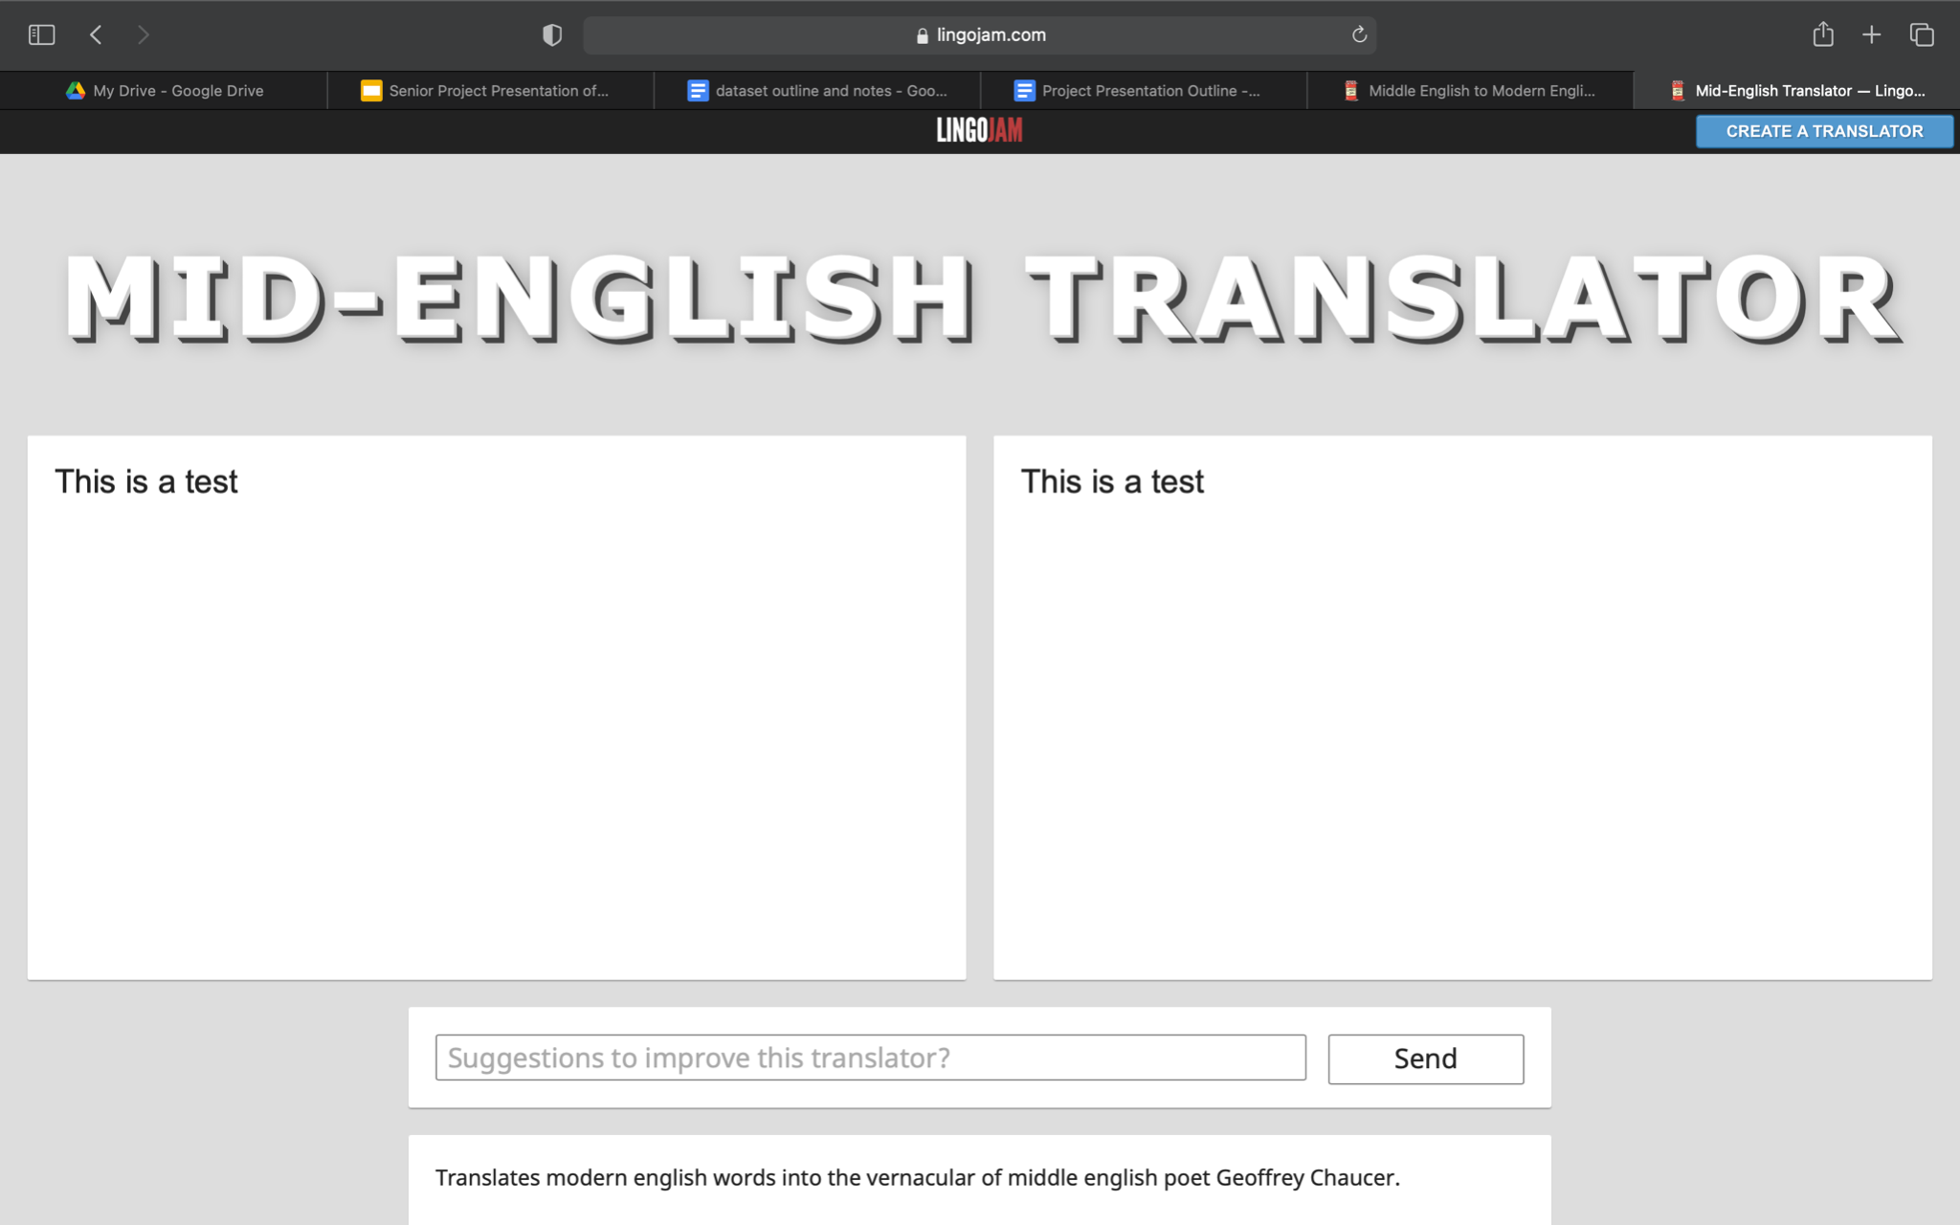
Current Middle English Translators
I’m trying to make something like this but better
Notes:
Currently, translators for Middle English do exist, I found these with just a quick google search
While they can translate a few lines of text, you can see they generally aren’t great
So I’m hoping to improve upon these translators with a new method of machine translation
Top translator: Middle English to Modern English Translator or the other way around ― LingoJam. (n.d.). Lingojam.com. https://lingojam.com/MiddleEnglishtoModernEnglishTranslator
Bottom translator: Mid-English Translator ― LingoJam. (2019). Lingojam.com. https://lingojam.com/Mid-EnglishTranslator

Slide 4

Neural Machine Translation
Notes:
When creating my machine translator, I decided to use neural machine translation
This is the most novel form of machine translation, and what google translate started using about five years ago
Image source: Wikimedia Commons

Slide 5
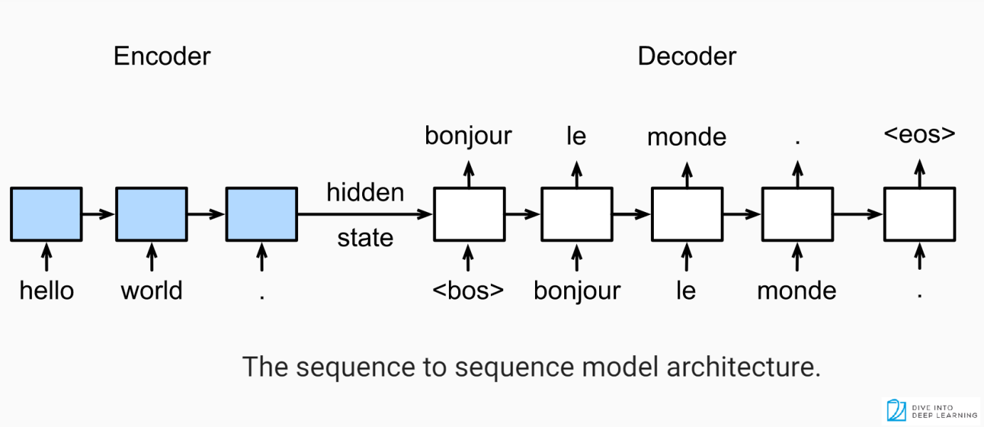
Notes:
Input sentence is “tokenized”
Encoded into a vector of numbers which represents meaning and embedded into what’s called a “hidden state”
In this state, the numbers in the vector are related to other vectors
The model picks the vector that most closely matches
One by one, the model uses the vector to guess the next token
Image source: Sobh, I. (2020, March 25). Anatomy of sequence-to-sequence for Machine Translation (Simple RNN, GRU, LSTM) [Code Included]. Www.linkedin.com. https://www.linkedin.com/pulse/anatomy-sequence-to-sequence-machine-translation-rnn-gru-sobh-phd

Slide 6
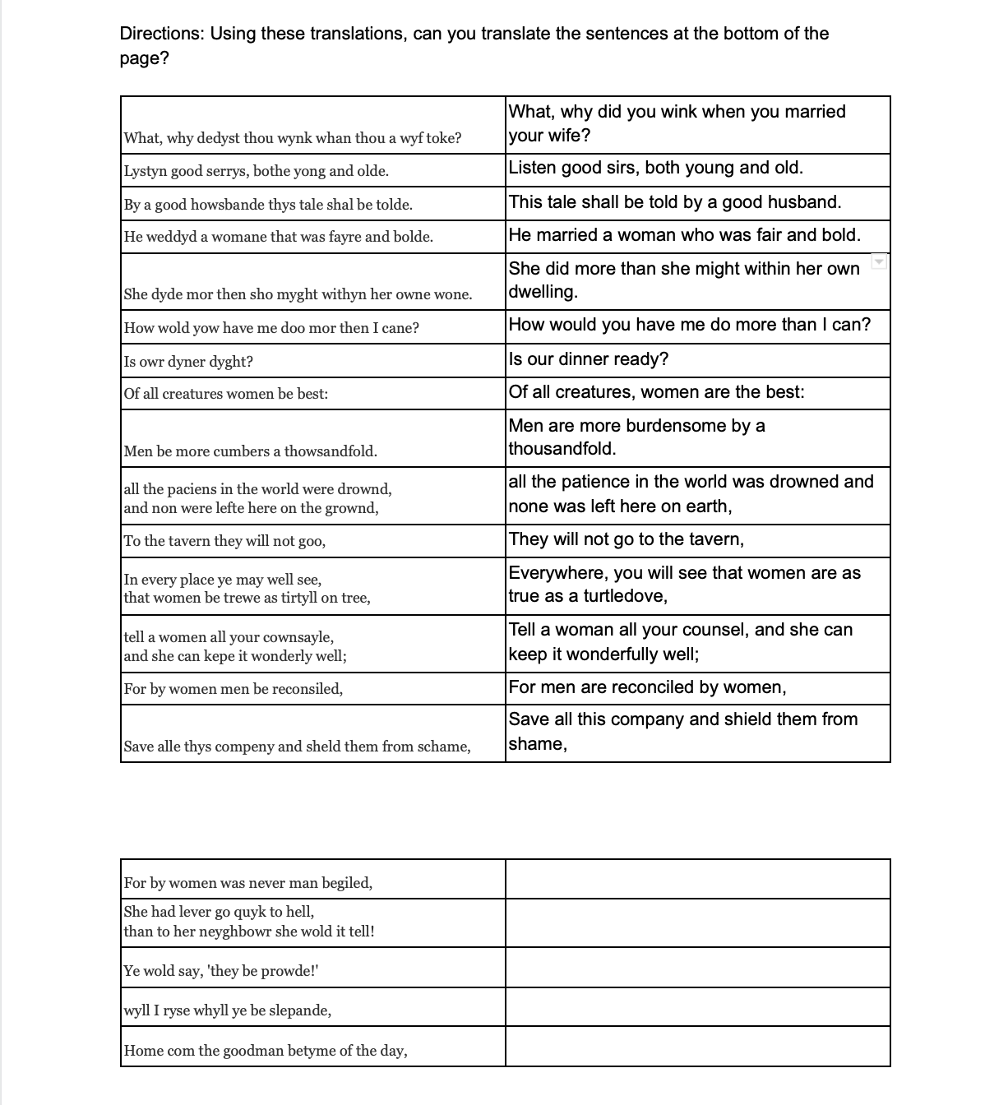
Handout - How the Model Learns
Middle English Training Data
Present-Day English Training Data
The only Middle English the model knows
The only Present-Day English the model knows
Middle English Test Data
Given sentences to measure the quality of the model’s translations
Notes:
What differentiates neural networks from other forms of machine translation is its ability to learn, this handout helps to show you what it is like to be a neural network
This type of dataset is called a parallel corpus
Remember that you have the advantage of years of training with modern english, making it easier to train with Middle English

Slide 7
The Two Pillars of Machine Translation
Neural Network Model
The machine that learns to translate Middle English - most of this is an open source German to English translator that I adapted
All the translations the model uses to train and evaluate itself - my original work
Data

Slide 8
Coding Process
01
02
03
Video Tutorial on Machine Translation
Change the model’s vocabulary
Load and Save Model
Developer Aladdin Persson explained open-sourced code for a German to English neural machine translation model.
Ensure the model can read my dataset by constructing it in the same way and reading it as English.
Ensure load and save files are unique to the particular model.
Notes:
I’ve tricked the dataset into thinking my data is part of it
Assumption: spacy tokenizer works for Middle English

Slide 9
Training and Evaluation Process
04
05
Training
Evaluation and Revision
Running the code many times to have the model practice and learn
Test quality, maybe add data or change the model’s constants
Notes:
After training for about 15-20 minutes on a portion of the data
Quality is measured by BLEU score
Hyperparamters are aspects of how machine runs, you can change them for optimization
Define BLEU score and hyperparameters

Slide 10
Origin of My Data
Benjamin Lambright
Rachel Chubb
Larry D. Benson
Annotations by Eve Salisbury:
Annotations by Eve Salisbury:
“Trials of Marriage”
“Ballad of the Tyrannical Husband”
Translated with other authors of The Riverside Chaucer:
“Ballad of the Tyrannical Husband”
“Abuse of Women”
“How the Goode Wife Taught Hyr Daughter”
The Canterbury Tales
Notes:
SPEND LESS TIME ON THIS SLIDE
Let’s start with talking about my data
When people are reading ME, they are mostly reading poetry, so that’s what I decided to focus on translating
You can see that I did some of the translating myself, and so did my friend Rachel
I got most of it from Chaucer, though
I got two types of translations, glossed and interlinear

Slide 11
Translation Methodology for Glossed Texts
01
02
03
Sentence Selection
Literal Translations
Tried to get one “complete thought”
Used footnotes and a Middle English compendium
Case Changes and Matching Punctuation
Change cases to help compile better and match punctuation to ensure the computer learns punctuation too
Notes:
For glossed tried to get complete thoughts
Operational definition of a complete thought:
Mostly independent clauses
If something was in quotes, we’d translate the whole thing in quotes
Difficult when in poetry
Tried to make translations as literal as possible
Used footnotes and UMich’s ME compendium
Changed cases to make it easier to put into datasets, this doesn’t matter because everything becomes lowercase later in the code
Made sure punctuation in translation matches because NMT translates punctuation too
Minor noted exceptions to all of these
Bottom image: Salisbury, E. (2002). The trials and joys of marriage (B. Lambright & R. Chubb, Trans.). Medieval Institute Publ., Western Michigan University. https://d.lib.rochester.edu/teams/publication/salisbury-trials-and-joys-of-marriage

Slide 12
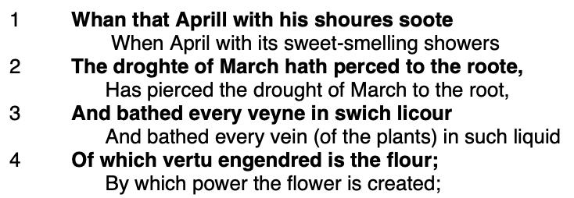
Transcription Methodology for Interlinear Translations
01
02
03
Sentence Selection
Lines combined until a semicolon, question mark, or period is found at the end of the line
Notes in Parentheses Removed
Line Numbers & Alternative Translations Deleted
Parentheses would confuse the computer
Included when copying the text but unnecessary for the translation
Notes:
Selected everything by line
Tried other ways but opted for this because it’s important to not have very long sentences
IBM recommends sentences between 5-20 words
Annotations removed, this is unnecessary for translation, must be as literal as possible
Line numbers might seem trivial but it’s important
image: https://sites.fas.harvard.edu/~chaucer/teachslf/gp-par.htm

Slide 13
Statistics on My Data vs. Standard
970 vs 1000
7,751 vs 11,000
8 vs 5-20
Lines in dataset
Middle English words in dataset
Words per Sentence
Notes:
About 1,000 lines and 7,500 words isn’t actually that bad, it’s like the default for recreational NMT like what I’m doing, but it’s the bare minimum
More than this and you need a more powerful computer training for a long time
You can see that good translations use a lot more on the left though. The amount of words they know is in the hundreds of thousands, and that’s about what you need to get a quality translation
My number of words per sentence is good though

Slide 14
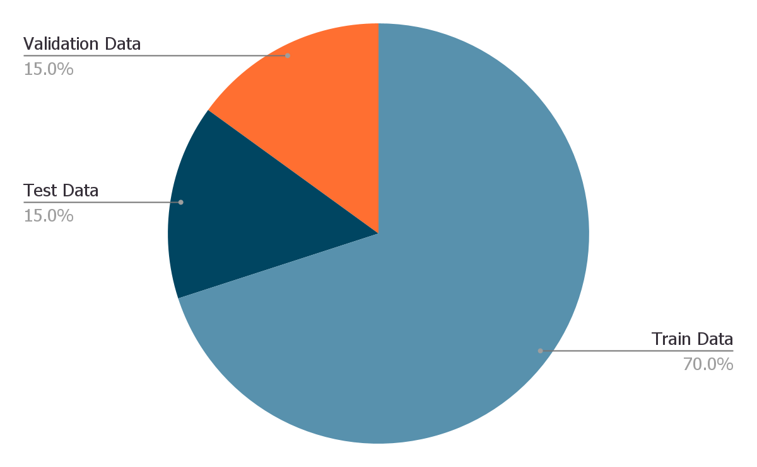
Data Processing - Splitting the Data
70%
15%
15%
Used for training the model
Used for optimizing the hyperparameters
Used for measuring the quality of the translations
Notes:
Tried different ratios of splitting the data but ended up with this one
It’s pretty standard

Slide 15
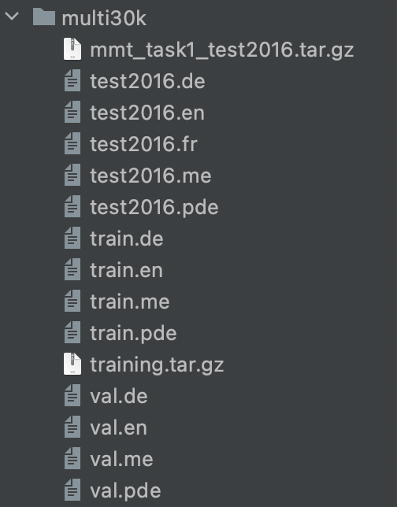
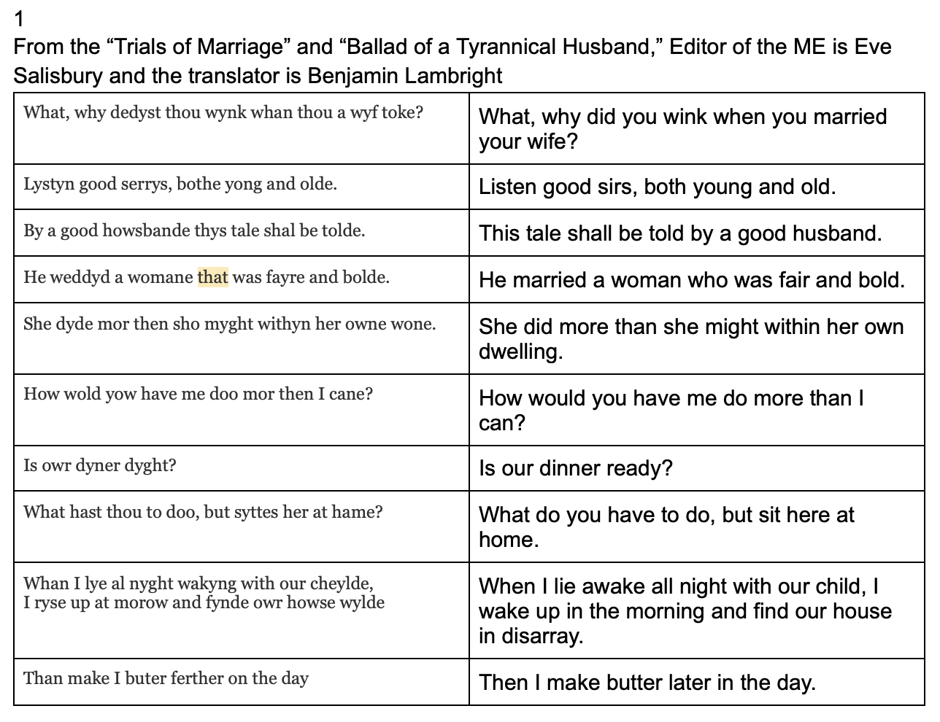
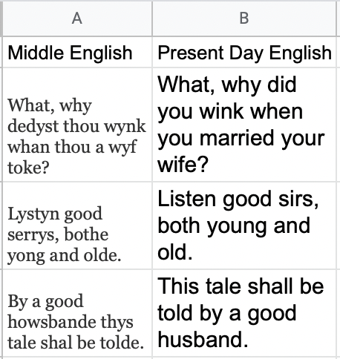
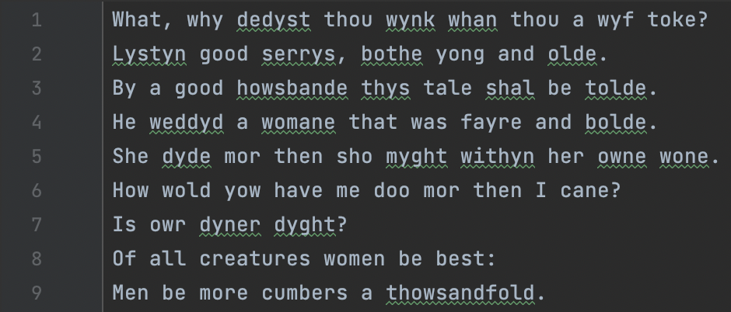
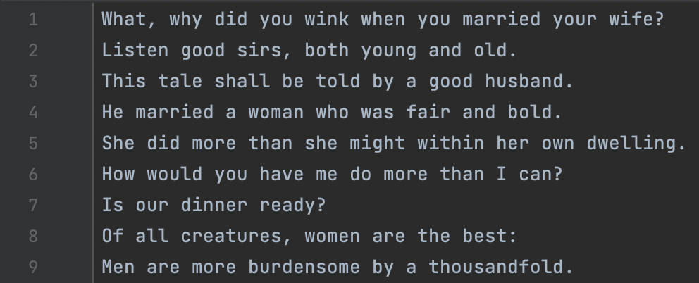
Data Processing - Glossed Text
01
04
02
03
Translate
Split into train, test, and validation
Nest in Multi30k
Split into “ME” and “PDE”
Notes:
The that is highlighted because I put notes in my translation
ME = Middle English
PDE = Present Day English

Slide 16
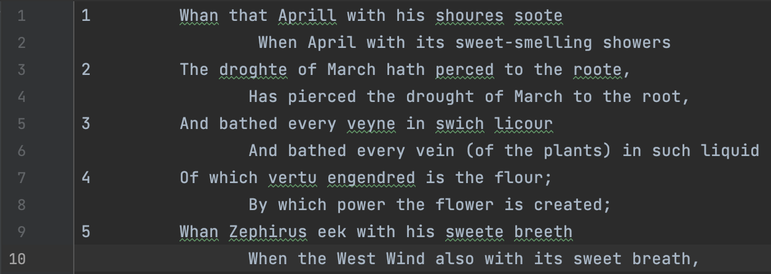
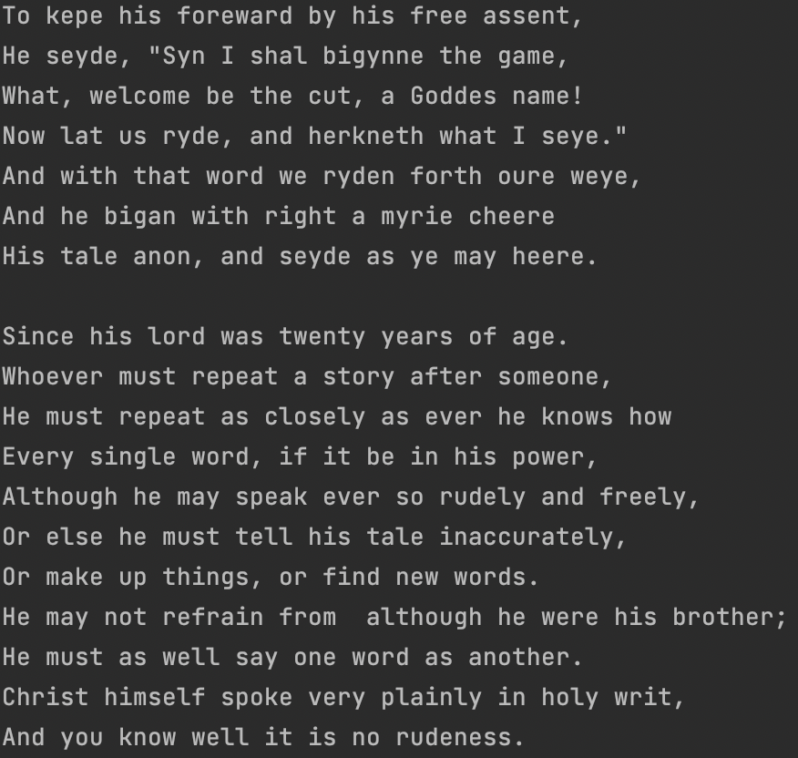
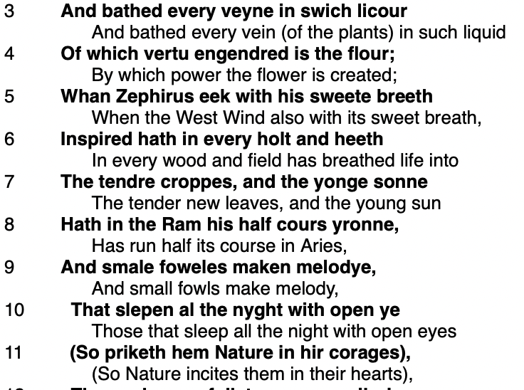
Data Processing - Interlinear Translations
01
02
03
04
Copying the Data
Listing each line
Splitting and Cleaning into “ME” and “PDE”
Data ready to copy into the nested files
X
☑
Notes:
I identified ME because it always has a line number and its translation always proceeds it
Cleaning includes getting rid of notes in parentheses

Slide 17
Demonstration

Slide 18


Slide 19
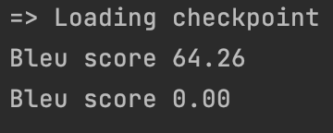
Results Analysis
~64%
1-3
0-4%
Of translations of train data match correct translations
Amount of words it normally recognizes from sentences unknown to the model
Of translations of test data match correct translations
Notes:
64% on training data is decent but could be better with more training
This suggests that it’s starting to understand the basic words but needs more training and data
So does the 0-4% statistic
It’s doing well given how much how much data it was able to take in

Slide 20
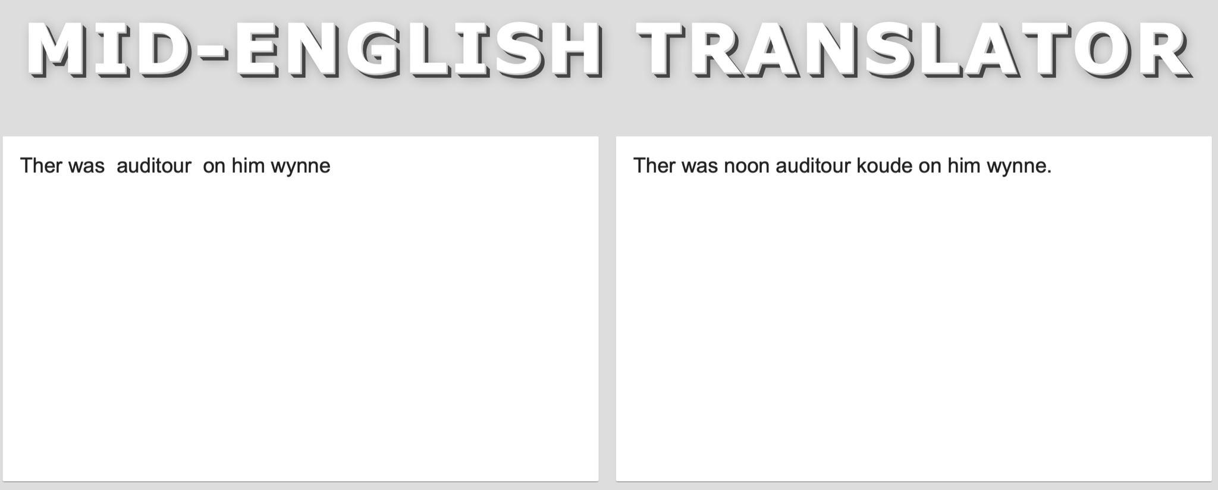
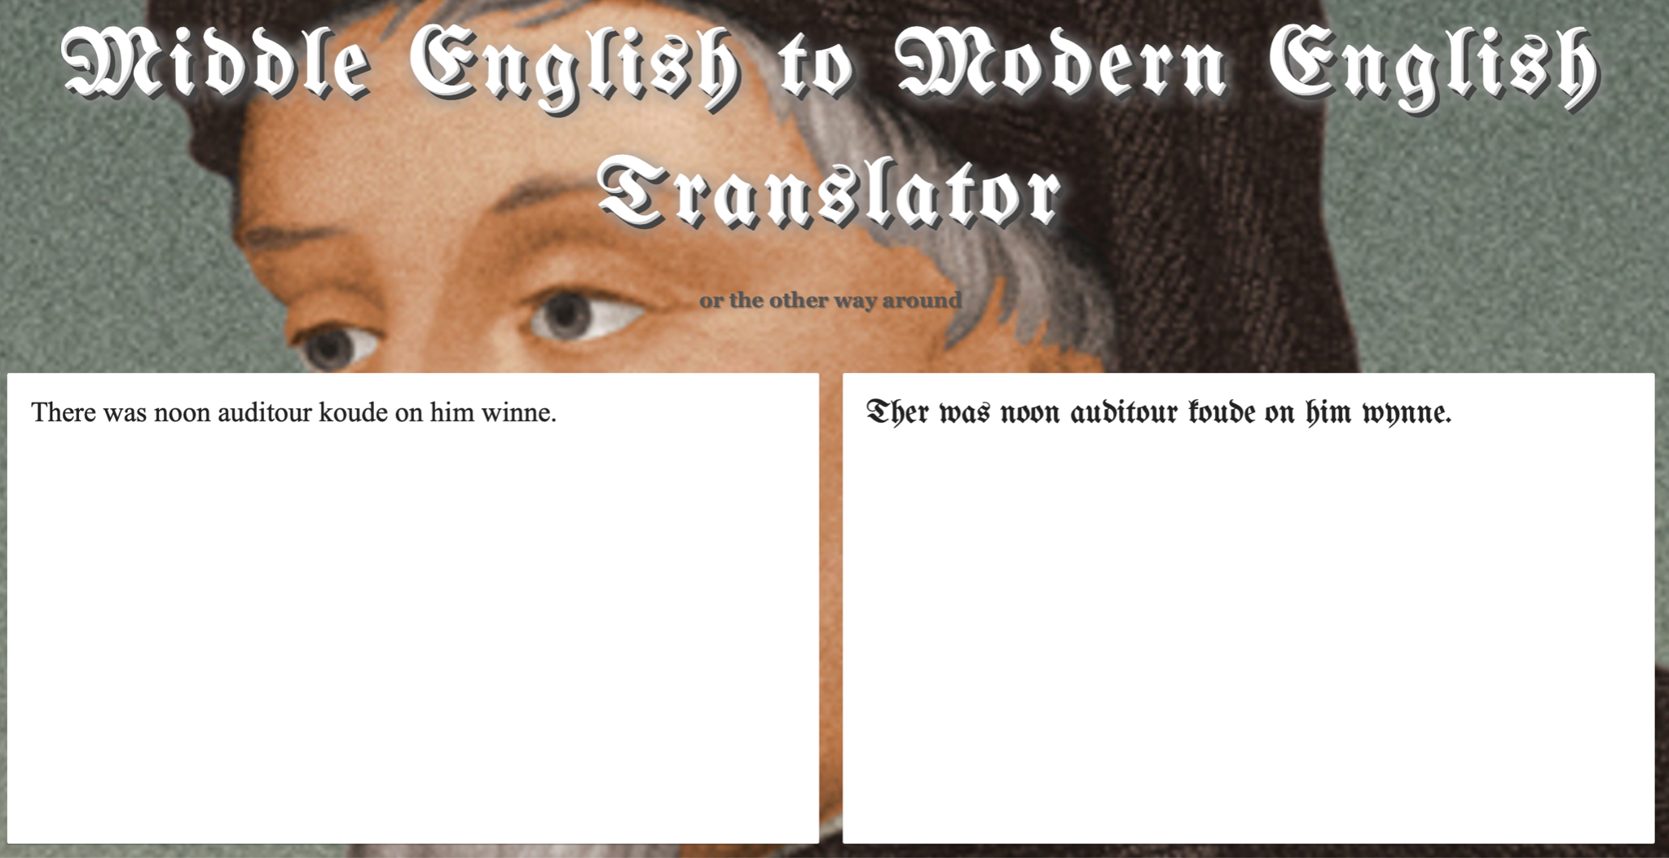
Comparison to Other Middle English Translators
Middle English to Modern English Translator
Mid-English Translator
My Model
Notes:
I took a sentence from Chaucer’s general prologue. My translator has trained on this, and you can see that it is the only one which remotely gets the correct translation.
It’s good with data it already knows, at least compared to other translators out there
Note that I don’t think that the other translators are using a neural network

Slide 21
Thank You!
Do you have any questions or comments?
All other citations are on the bibliography document that was turned in separately.

